Slide 1

Nick’s Hard CTF
(Network Analysis)

Slide 2
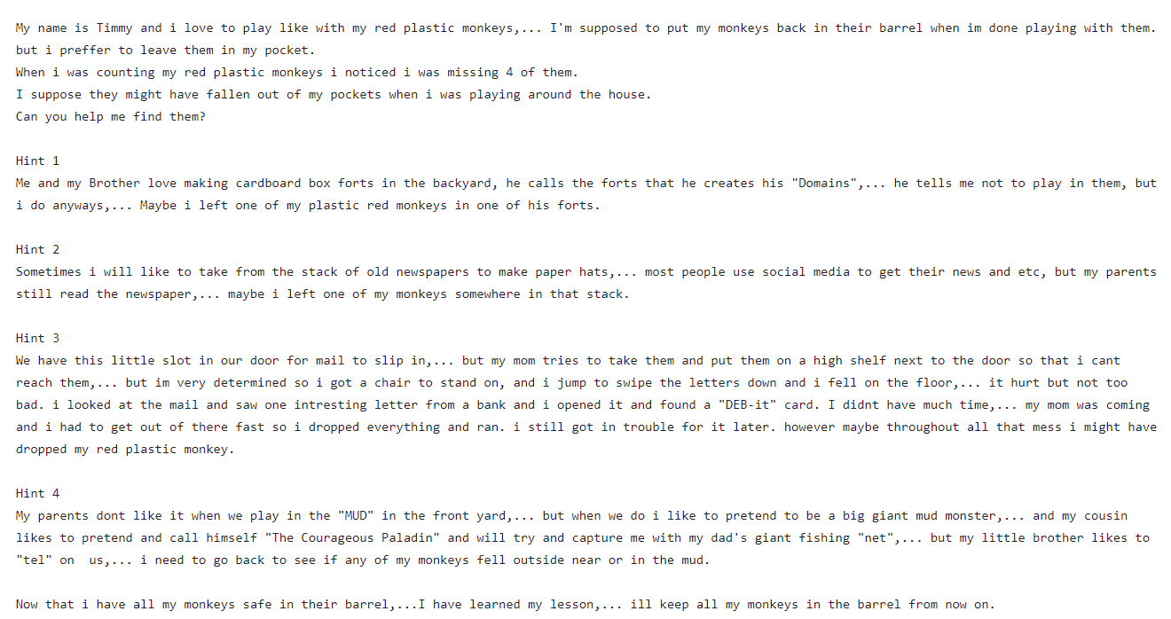
- read the theme of the ctf

Slide 3
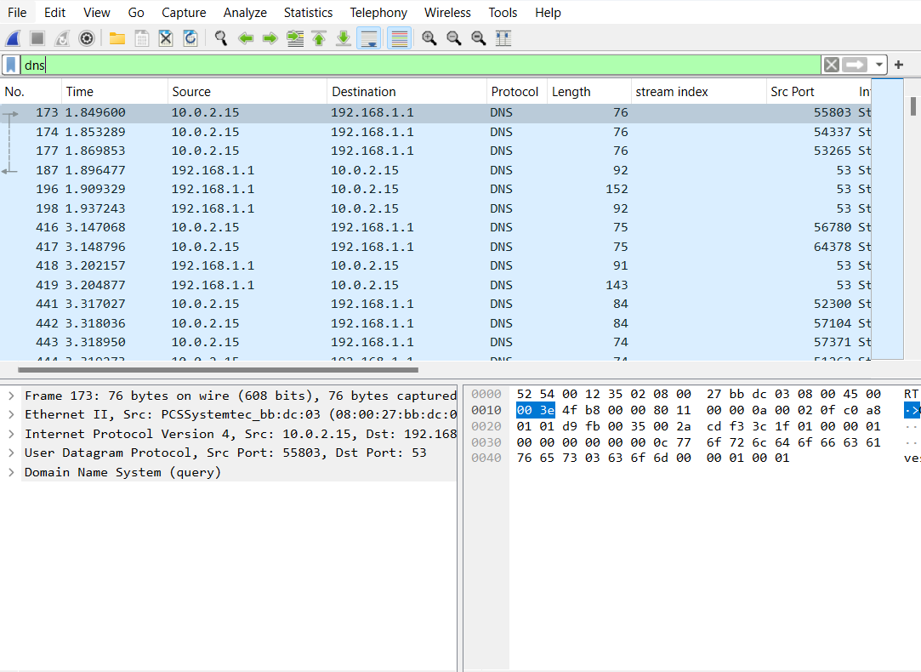
- Download Pcap file - Open file with Wireshark. - Use Hint to help discover what to filter for,… which in this case is “DNS”

Slide 4
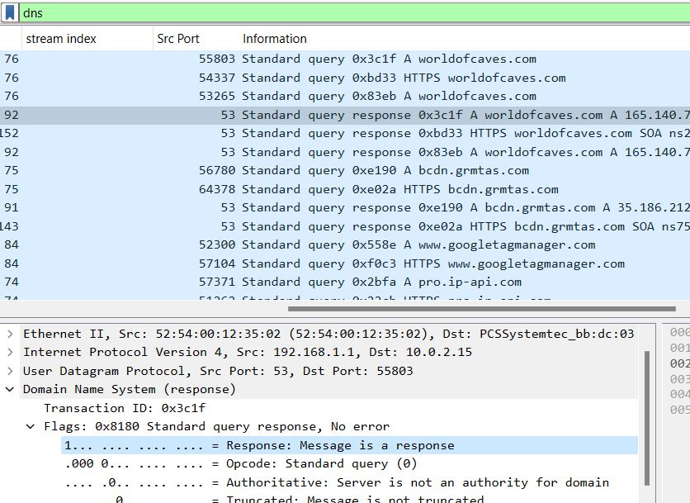
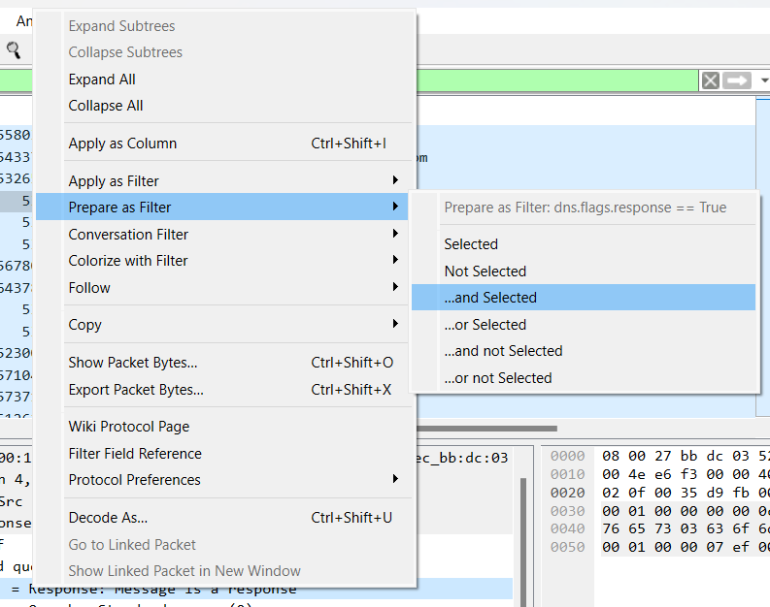
- Narrow down search by filtering out the response packets. - Add highlighted section to the filter by right clicking to “prepare as filter”.

Slide 5

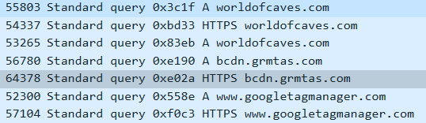
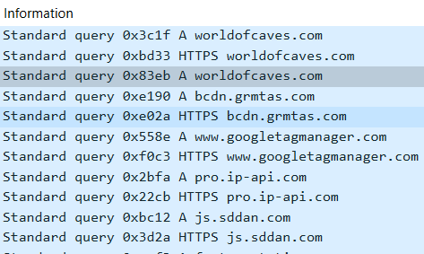
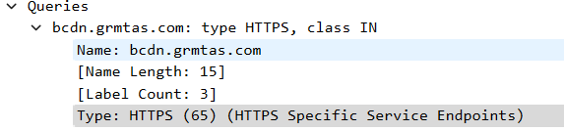
- Switch the bit value from 1 to a 0 by switching the “True” value to a “0” - Further narrow down your search by filtering out the “HTTPS” type by right clicking the selected area in the packet and prepare as filter. Then place the “!” before the newly added filter to specify that you want to exclude this in your results.
Right Click,… to add and prepare as filter.

Slide 6
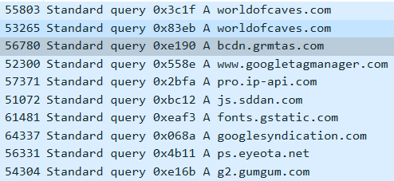
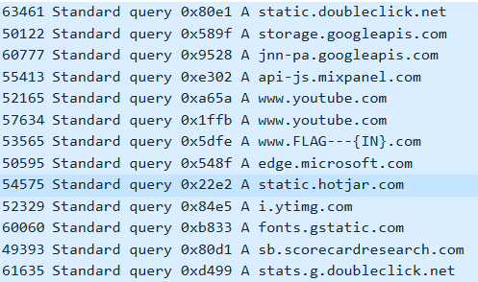
- Apply the filter to discover the total amount of packets decreased by half. -Scroll down to find the FLAG - Add “IN” to your notes.
SCROLL DOWN

Slide 7
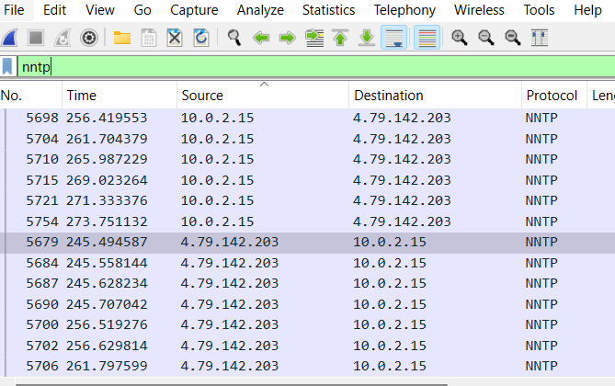
- Read 2nd hint to help discover what to filter for. - Make a list of all the protocols used in the pcap file and research each one to eventually discover that NNTP relates to the hint. - Filter for NNTP,… We now have 26 packets displayed!

Slide 8
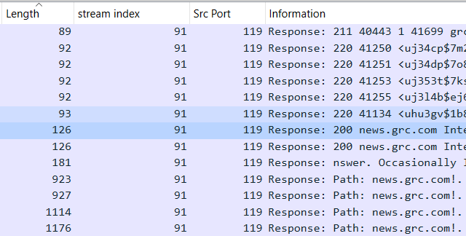
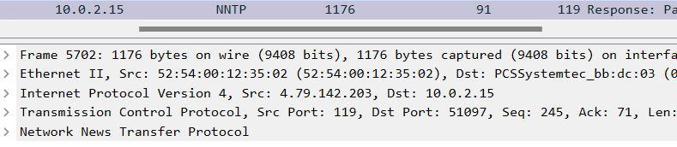
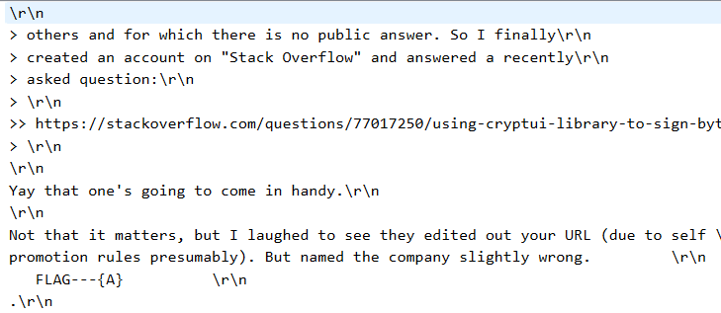
- Look at the “length” Column to determine packets that contain more than the average amount of bytes. - These packets are more than likely to contain data. - Click on the packet that contains 1176 bytes to eventually discover the flag,… and add to notes.
Click
Click
FLAG

Slide 9
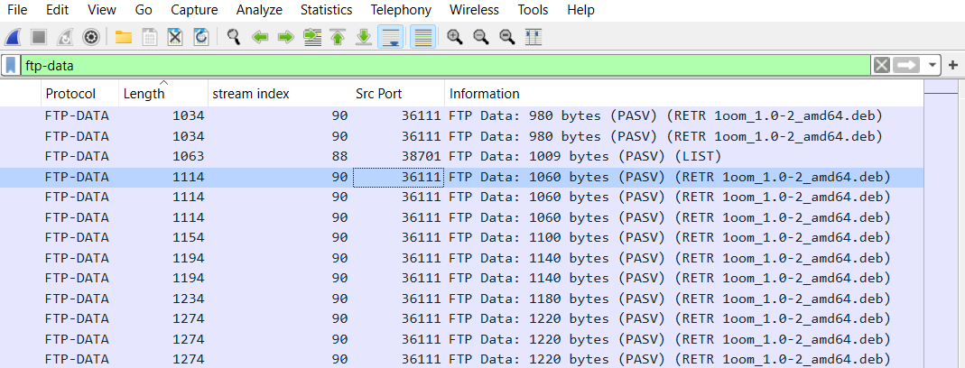
- Read 3nd hint to help discover what to filter for. - Refer to your list of protocols that you made from earlier. - Filter for FTP-DATA
- Discover that the host is downloading a .deb file,... This matches the hint which shows we are in the right direction.

Slide 10
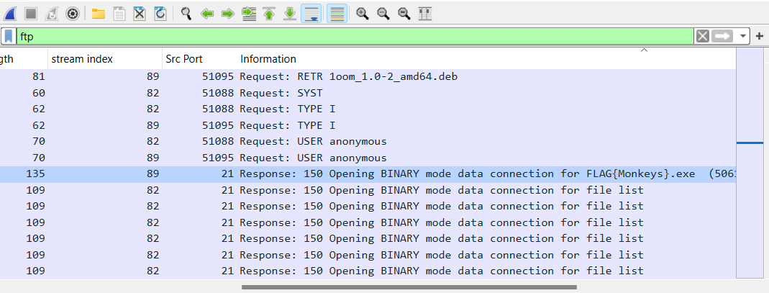
- Opening up each packet to look for the flag is time consuming,... Total of 363 packets! Way to many. - We will filter for FTP first before resorting to doing that. - Click on “Info” column in order to group the information and organize it to read it better. - Look at the results to discover the FLAG and add it to your notes.
Click
FLAG

Slide 11
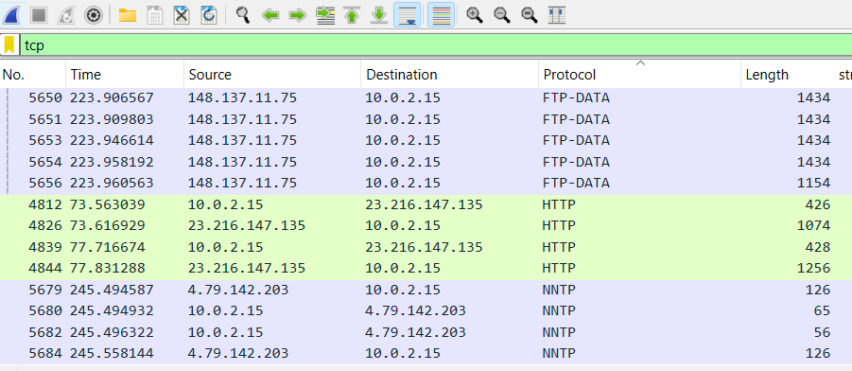
- Read 4nd hint to help discover what to filter for. - The hint provides a clue that we should filter for TCP. We will go ahead and do exactly that. - Click on the “protocol” column to discover that TCP apparently isn’t the only protocol in the results.
click
WHY?

Slide 12
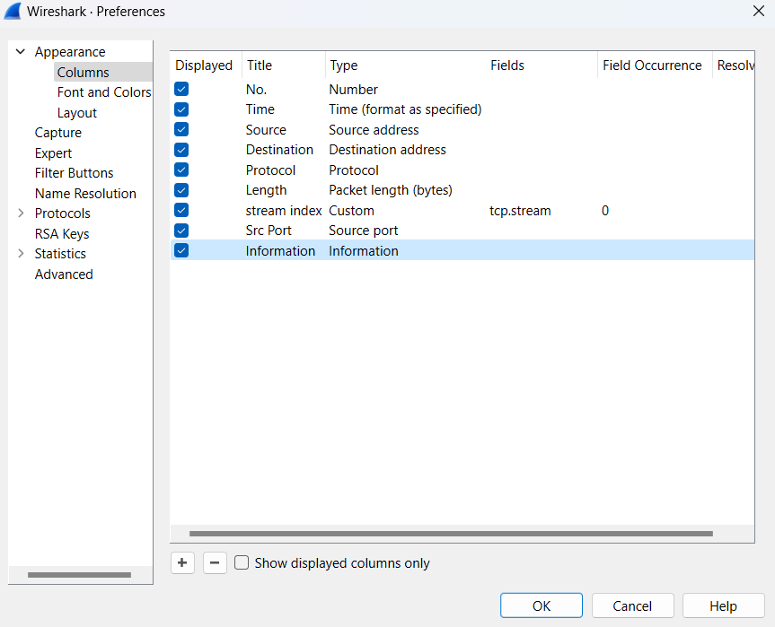
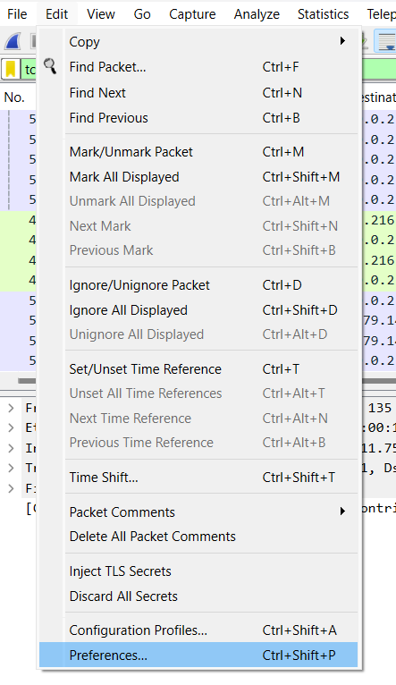
- Create a new column to display the source ports of all packets. - Click “edit”,… “preferences”,… and a new window will appear. - “Columns”,… “+” button,… add configurations,… press “OK”.
click
click

Slide 13
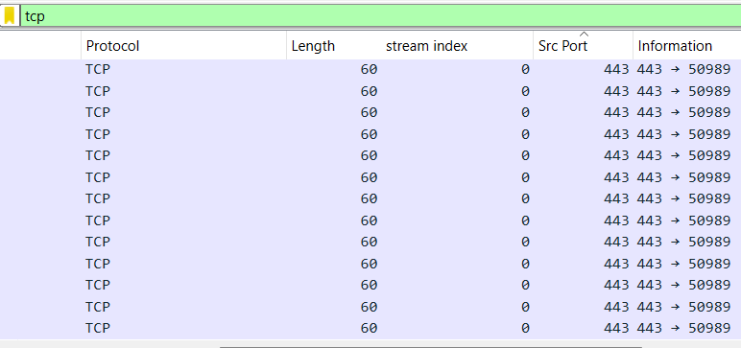
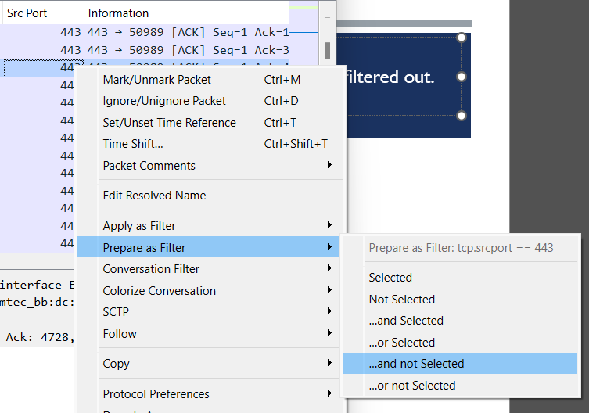
- Click the “Source Port” column to group and organize the ports. - Scroll down to discover HTTPS on port 443 which we know is Encrypted and useless and needs to be filtered out. - Right click port 443 and click “prepare as filter” and then click “and not selected”.

Slide 14
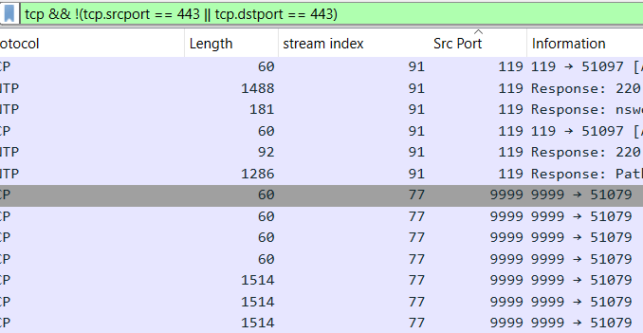
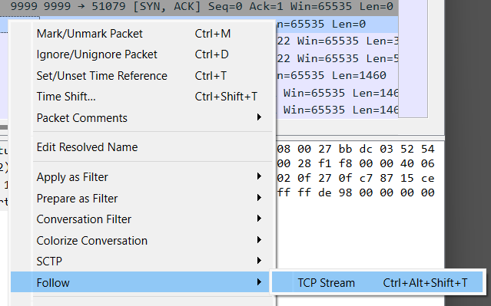
- Now add to the filter by specifying all 443 destination ports by typing,… “ || tcp.dstport == 443” ,…and apply. - This will permanently get rid of HTTPS and will display 768 packets! - Scroll down a little bit to find a Suspicious port of 9999. - Right click on any of the packets and then follow it’s TCP STREAM.
ADD
APPLY

Slide 15
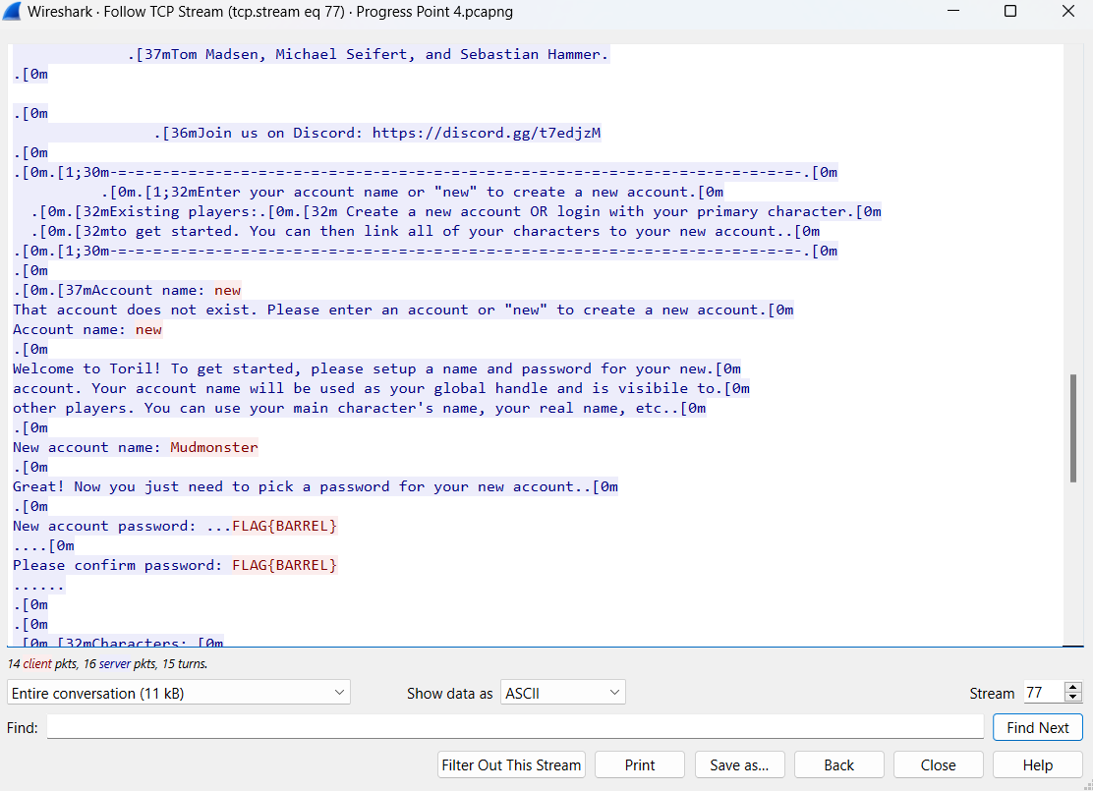
- Another window will appear. - Everything is in plaintext. - Scroll down to find the flag. - Add flag to notes
FLAG

Slide 16
- Look at your notes containing all the flags you found to piece them together to reveal the hidden sentence.
{Monkeys}---{IN}---{A}---{BARREL}

